Slide 1
Title
By Authors’ First and Last Names

Slide 2
Introduction
There must be a small description about you and your partner
There must be a video of either you or your partner dancing

Slide 3
Cartoon Character
What cartoon character are you or your partner most like?
Why do you think that? Is it a personality trait that is similar, you look like them or you get how this character feels?
Must include a picture of the character on this slide
Must cite the picture

Slide 4
Places
Where was the best place you have ever been? Or want to go?
Why there? What memories does it bring up?
Must include a picture of the place
Must cite the picture

Slide 5
Hobbies
What are hobbies/ sports/ activities that you participate in?
What makes these so cool?
How could I join if I wanted to?
Must have a picture of the hobby
Must cite the picture

Slide 6
Gif
This is the conclusion of your presentation
How do you want it to finish? What do you want people to remember about you?
Must include a Gif
Must cite the Gif

Slide 7
Citation
Every picture
Every fact
Make sure it is credible sources
Where did you find it?
Made every source have a title

Slide 8
All About US
By Ms. Jo and Mr. Gardner

Slide 9
Some Things to Know…
JO
G
Lived in New York for a year
Has a pet turtle
Named Mr. Turtle
Coached WNBA athletes
Is getting married this summer

Slide 10
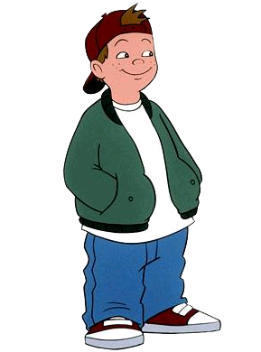
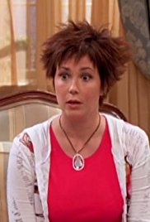
Famous people trying to be us
Jo
G
Mom Suite Life
Twinsies!!
Chill and accepting but Still Mom
TV show Recess
TJ Detwieler
Leader of friend group
Like to play sports have fun
(Suite Life)
(Recess fan)

Slide 11
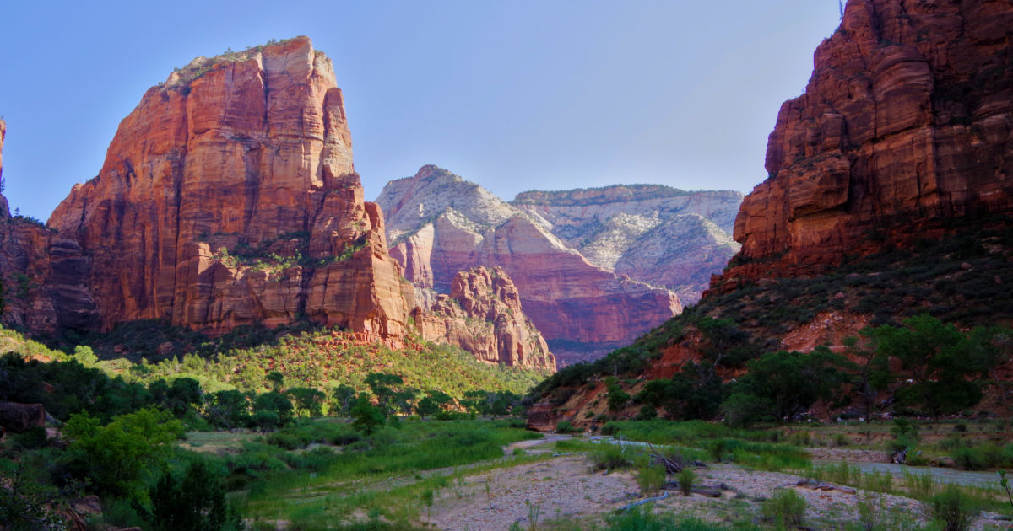
Oh the Places You’ll GO!
Jo
G
Zion National Park
Colorful and feels like home
Have been to Hungary
Want to go back so BAD!!
Going to New Zealand for Honeymoon
(Hungary)
(Zion)

Slide 12
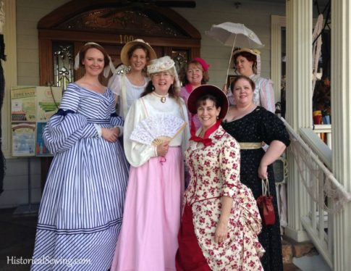
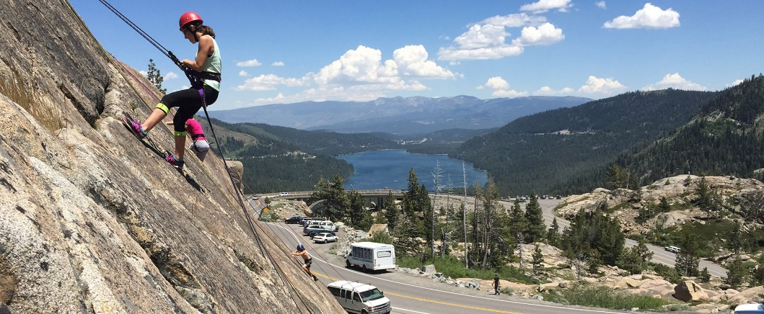
What We Do
Jo
G
Historic Costuming
Hiking
Snow Showing
Mine Craft
Rock Climb
Basketball
Madden
Cook
(Donner)
(Costuming)

Slide 13
Thank You for Viewing
(Thank you Dance)

Slide 14
Works Cited
Recess Fan https://recess.fandom.com/wiki/T.J._Detweiler
Suite Life https://www.imdb.com/title/tt0862404/
Hungary https://www.youtube.com/watch?v=ppyzJFjmzT8
Zion https://www.budgettravel.com/article/zion-national-park-guide
Donner http://www.tahoedonner.com/amenities/activities/rock-climbing/
Costuming https://historicalsewing.com/why-we-are-involved-with-historical-costuming
Thank you Dance https://anz23mobilethings.wordpress.com/category/house-keeping/

